Slide 1


Explore different Boroughs in London
Lin Yang
10/01/2019

Slide 2
So many Boroughs in London, what are they like?
Imagine you are the first time comer to London, where should you live? What are all the areas like ? Are they expensive? Are they safe?
With all these questions in mind, let’s have a look at what are the data available to tell us some insights about London….
There are 33 Boroughs in London, and
We find house price data for all of them, and
Both crime data and education data are also ready to use……

Slide 3
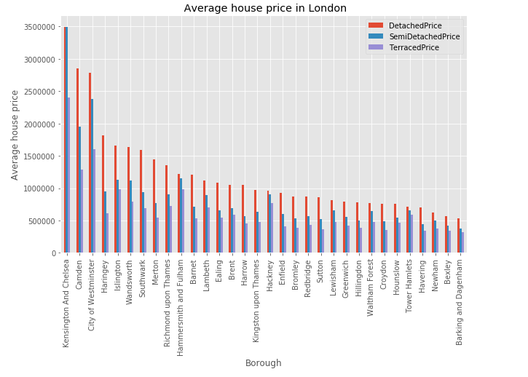
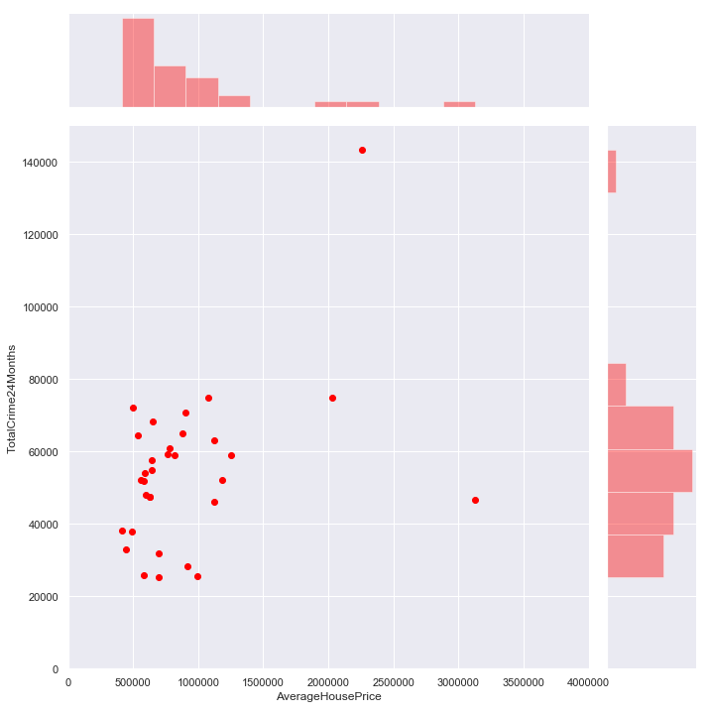
Descriptive Statistics
How expensive of houses in London?
Kensington and Chelsea, Camden, City of Westminster can have house price that 5 times more than all other areas, using detached house as example : the 3 area have average price of 2.5 to 3.5 million pounds, where average price of other area of London is 0.5 to 1.0 million pounds.
How safe is London?
It is very interesting to see that some high price area (average price of house 2.0 to 2.5 million pounds) are actually have the highest reported crime. A sensible explanation could be rich area would actually encourage more crimes to take risk.

Slide 4
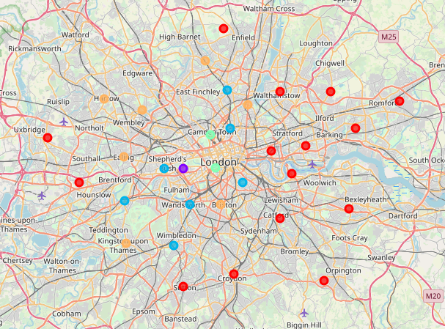
So how can I make my life easier and ask machine to group all the regions to only a few groups ?
K-means clustering is utilised in the analysis, we feed the machine a few set of features about the area (such as price, crime rate, education), and ask machine to provide us a map on the right.
5 colours of dots are provided by the machine. In a nutshell, if you chose to live in a red dot in west London, it will be quite similar to any other red dots on the map!
However, chose to live at a Red dot , it can be quite different from live at a Blue dot.

Slide 5
Conclusion and further recommendation
Is my data really tell me the whole story?
It doesn’t mean Blue dots are definitely better than Red dots! They are just Different!
Certainly you would like more than just price, crime and education to decide where you want to live….
They are just different, because machine learning clustering is an unsupervised process, it is up to human to decide how to interpret the result, and tell machine what you would prefer!
Be mindful on the features you can chose to feed the machine, maybe you like more than 5 clusters, maybe we you want to consider how many grocery store or yoga studios are there.
Be curious, if a Brough have high crime rate but most of them are robbery, and another area has low crime rate but all of them are murder, would the crime rate be the ultimate parameter to use?

Slide 6
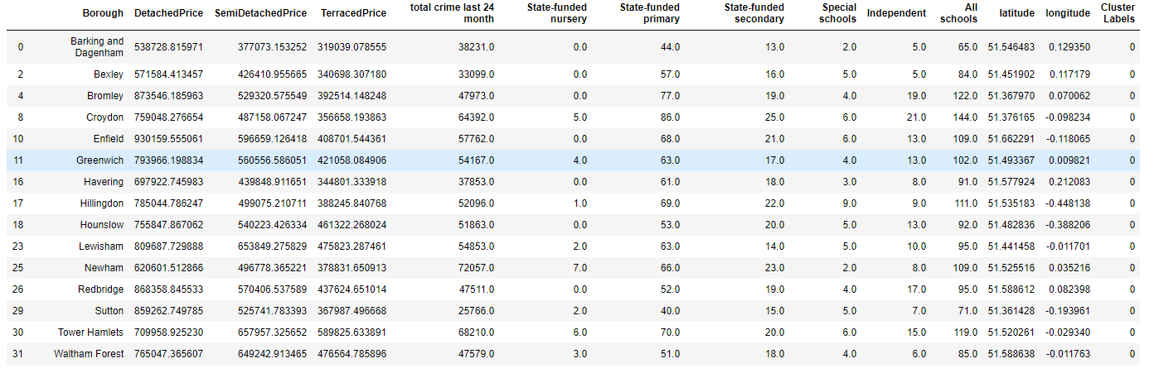
Appendix
Cluster 0
Cluster 1

Slide 7
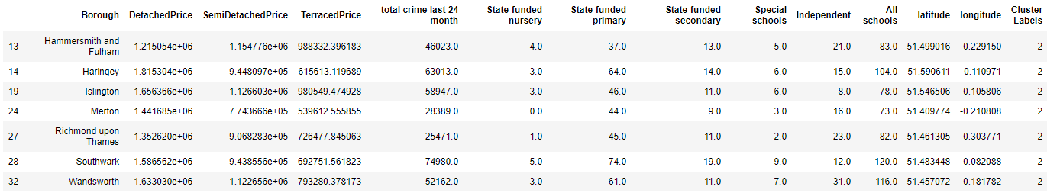
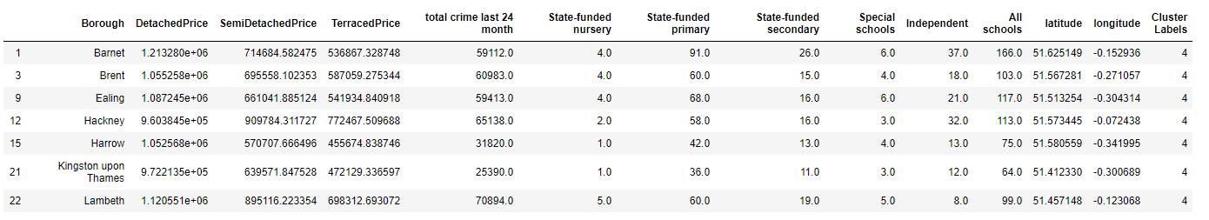
Appendix
Cluster 2
Cluster 3
Cluster 4

Slide 8
Appendix
Data Source
DATA | WEBPAGE LINK
UK House Price Index | https://www.gov.uk/government/publications/about-the-uk-house-price-index
Data Dictionary | https://www.gov.uk/government/publications/about-the-uk-house-price-index/about-the-uk-house-price-index
Recorded Crime: Geographic Breakdown | https://data.london.gov.uk/dataset/recorded_crime_summary
Schools and Pupils by Type of School, Borough | https://data.london.gov.uk/dataset/schools-and-pupils-type-school-borough
List of London Boroughs | https://en.wikipedia.org/wiki/List_of_London_boroughs
Python Notebook
Github Repo | https://github.com/linyang1987/Coursera_Capstone/blob/master/Data%20Science%20Final%20Project.ipynb

